Slide 1


Slotted Random-Access Wireless Network
TOMMASO BURLON
Francesco Iemma
Olgerti xhanej

Slide 2
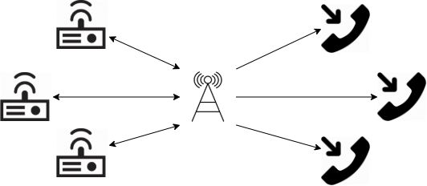
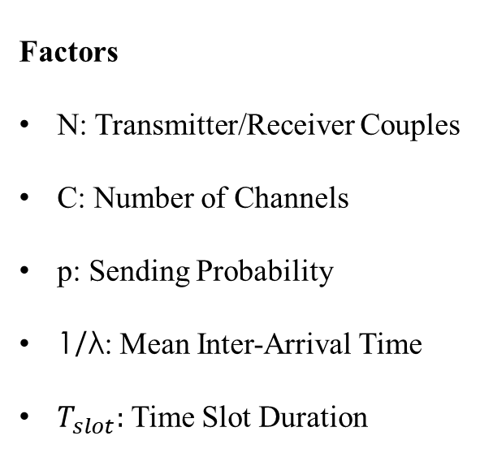
Modelling
General Assumptions
Slotted
Constant Packet Size
No Propagation Error
Unbounded Queues
Tx/Rx Synchronization
Collisions and Channel choice
KPI
Throughput
Response Time
Mean Number of packets in the queue
Factors
N: Transmitter/Receiver Couples
C: Number of Channels
p: Sending Probability
1/λ: Mean Inter-Arrival Time
$T_{slot}:$ Time Slot Duration

Slide 3
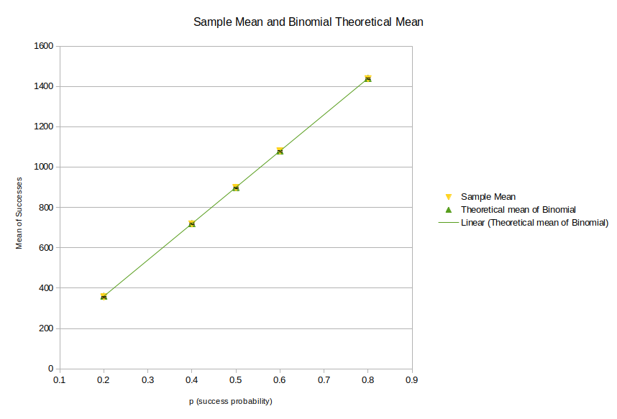
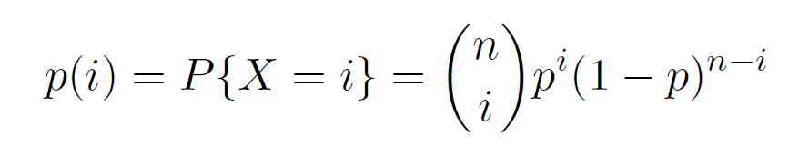
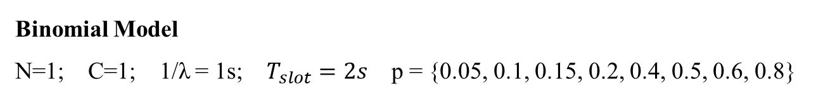
Verification (1)
Tests Performed
Continuity Test
Consistency Test
Degeneracy Test
Binomial Model
Collision Model
Binomial Model
N=1; C=1; 1/λ = 1s; $T_{slot}=2s$ p = {0.05, 0.1, 0.15, 0.2, 0.4, 0.5, 0.6, 0.8}

Slide 4
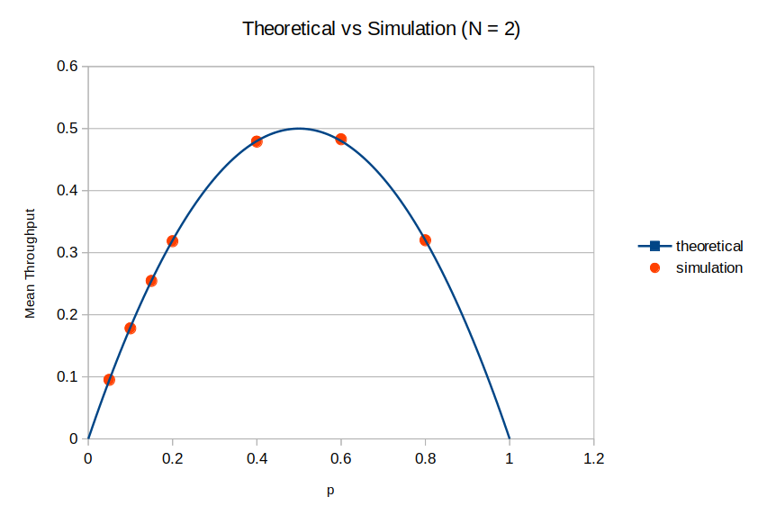
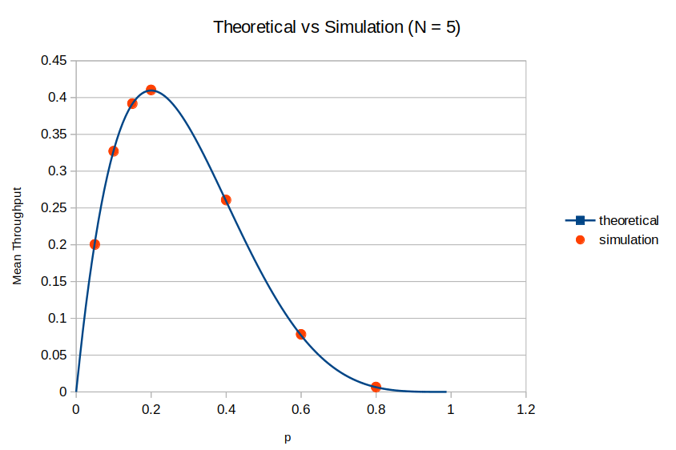

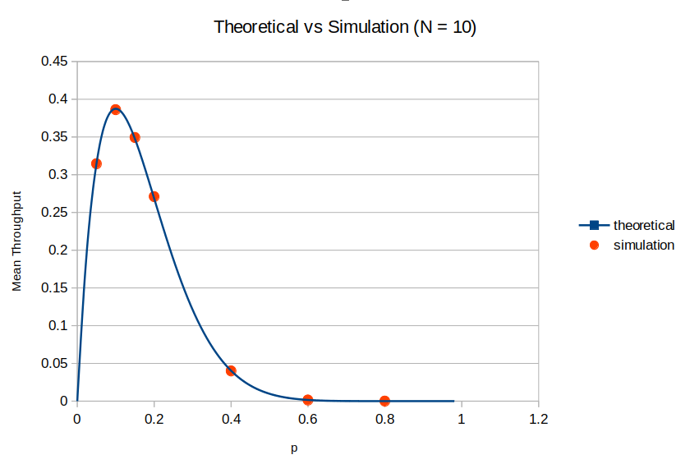
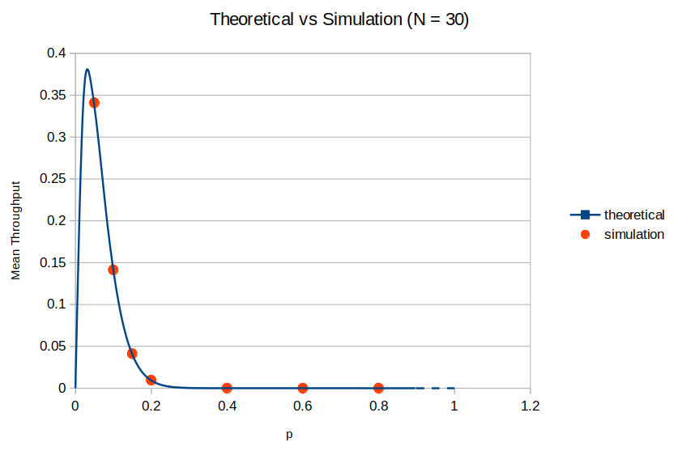

Verification (2)
Collision Model
The probability of a successfull transmission is equal to the probability that only one tx transmit, i.e.:
The latter can be seen as the mean throughput of the system in the single channel case:

Slide 5
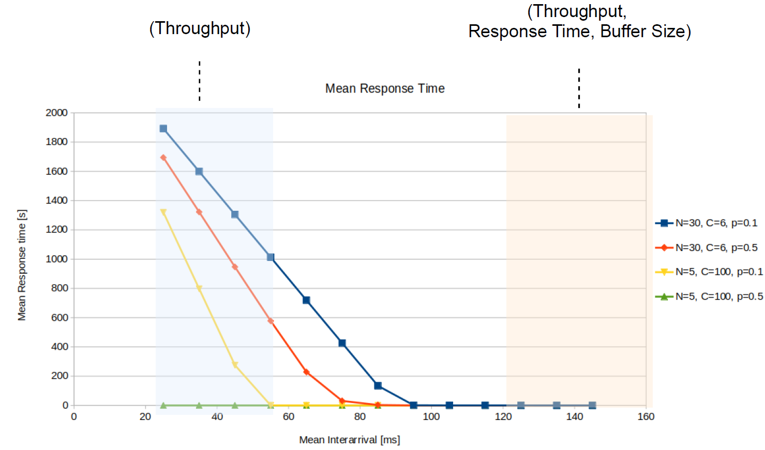
Response Time Limits

Slide 6
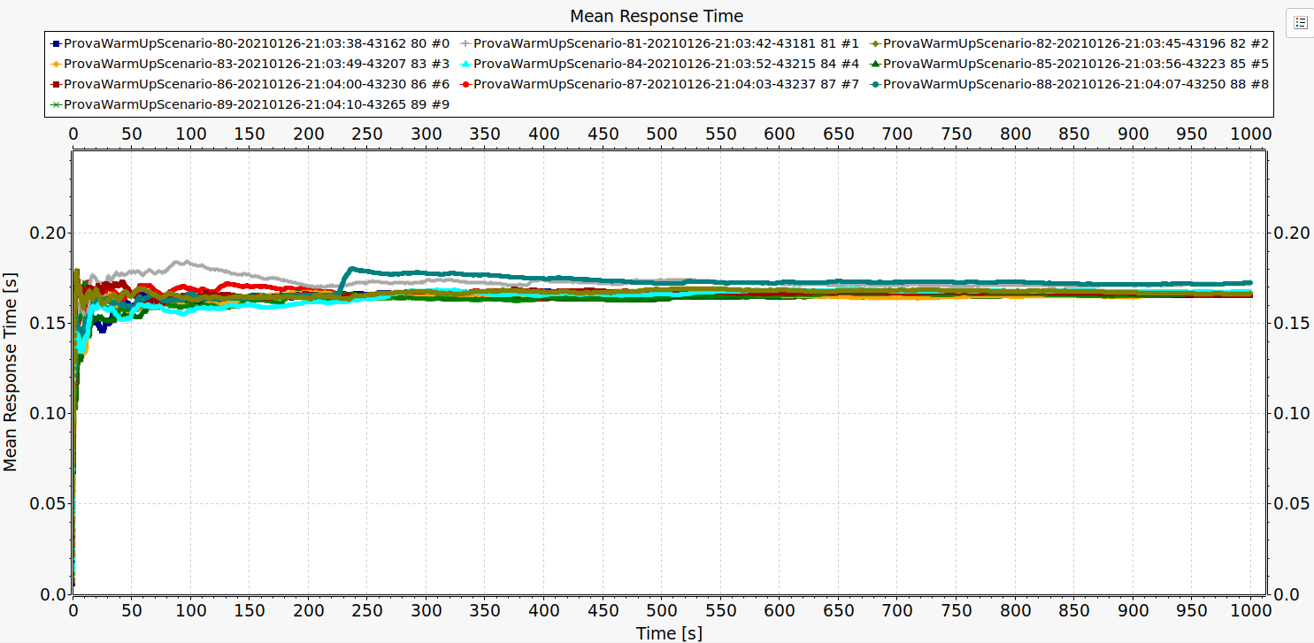
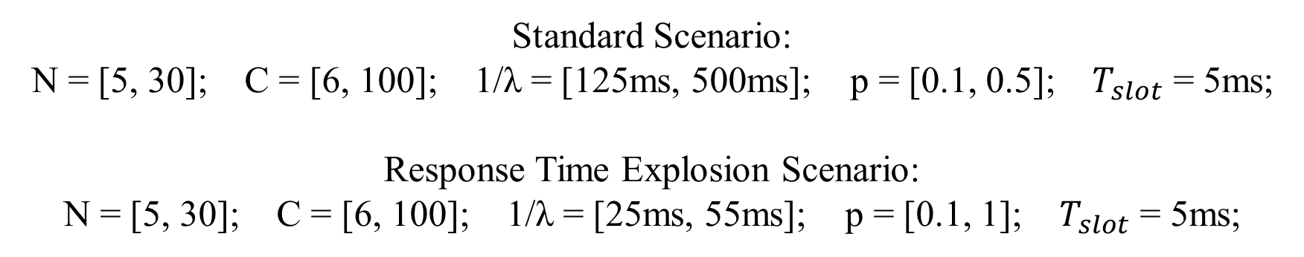
Scenario Calibration
WARMUP:
250s
SIMULATION DURATION:
5000s
Standard Scenario:
N = [5, 30]; C = [6, 100]; 1/λ = [125ms, 500ms]; p = [0.1, 0.5]; $T_{slot}$ = 5ms;
Response Time Explosion Scenario:
N = [5, 30]; C = [6, 100]; 1/λ = [25ms, 55ms]; p = [0.1, 1]; $T_{slot}$ = 5ms;

Slide 7
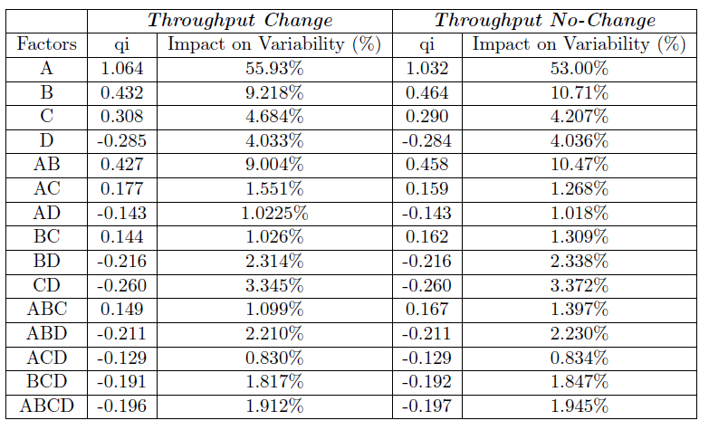
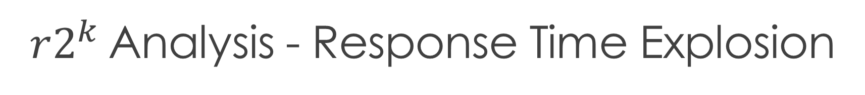
$r2^{k}$Analysis - Response Time Explosion
A: Number of Couples Tx-Rx; B:Number of Channels; C: Send Probability; D: Mean Inter-Arrival time

Slide 8
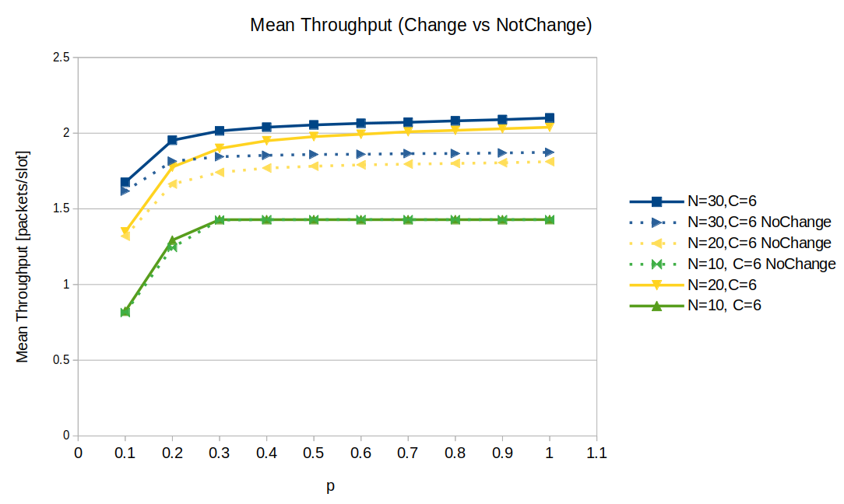
Response Time Explosion Scenario

Slide 9
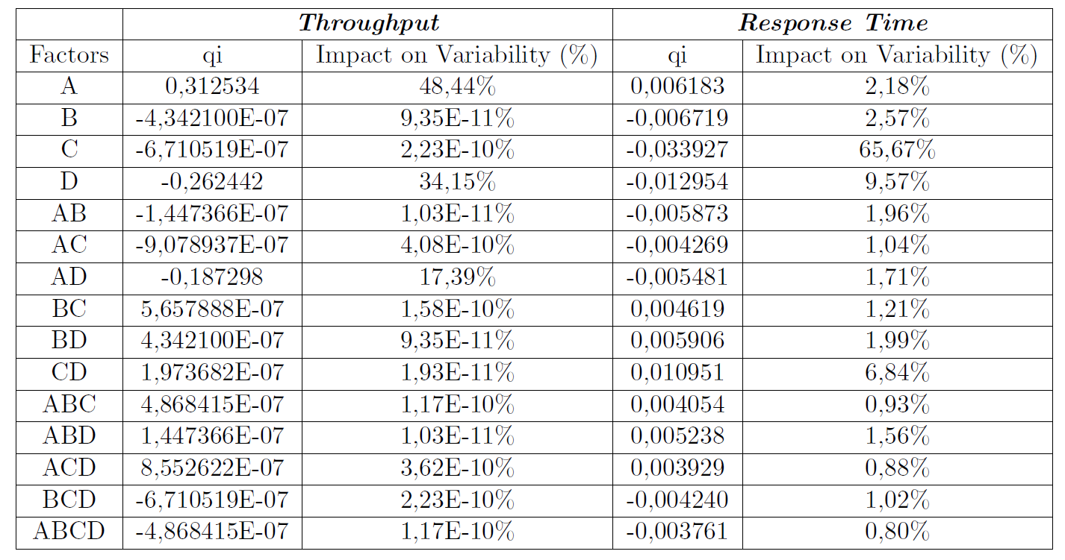

Analysis $r2^{k}$ - Standard Scenario
A: Number of Couples Tx-Rx; B:Number of Channels; C: Send Probability; D: Mean Inter-Arrival time

Slide 10
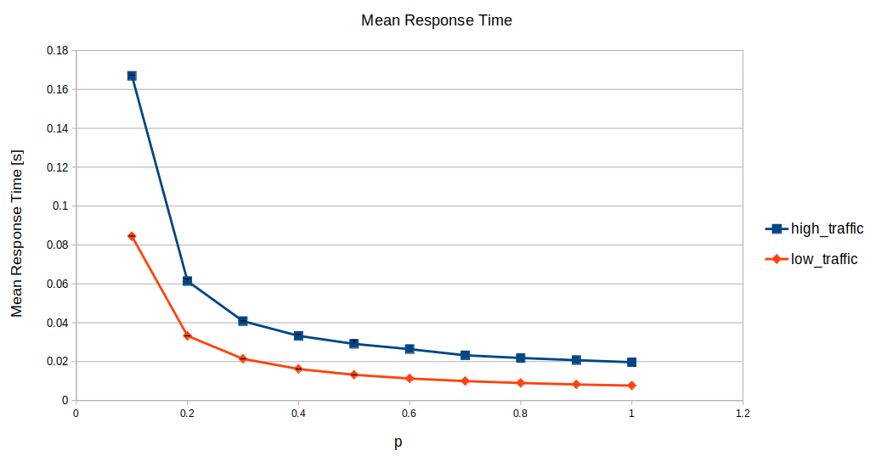
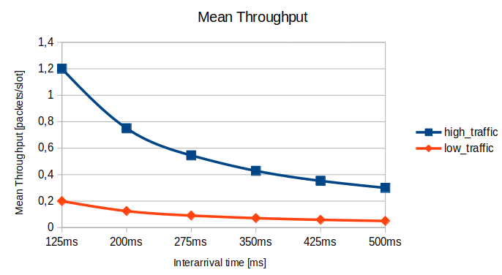
Conclusions
High Traffic Scenario
N = 30; C = 6; 1/λ = 125ms
Low Traffic Scenario
N = 5; C = 100; 1/λ = 125ms
High Traffic Scenario
N = 30; C = 6; p = 0.1
Low Traffic Scenario
N = 5; C = 100; p=0.1

Slide 11
SLIDES ULTERIORI

Slide 12
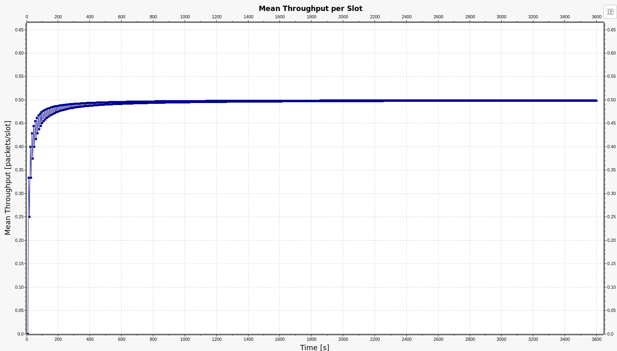
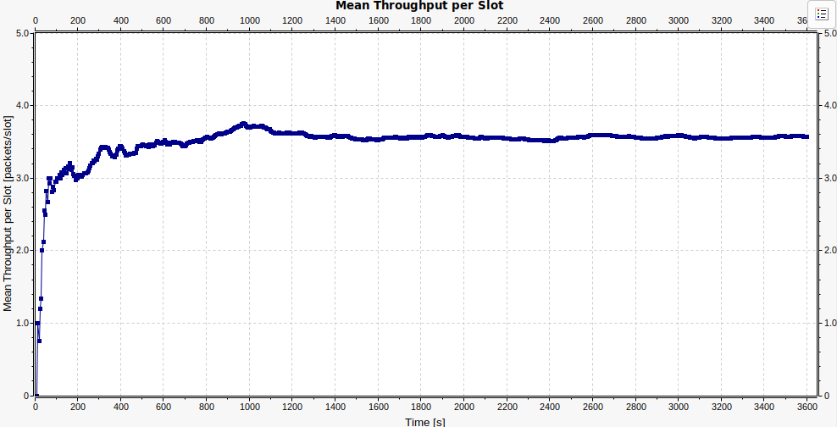
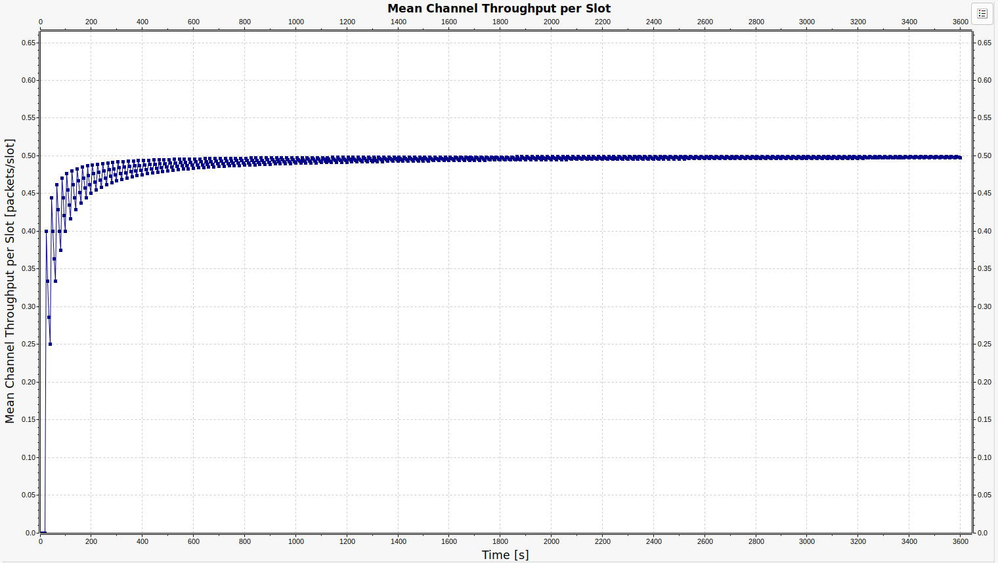
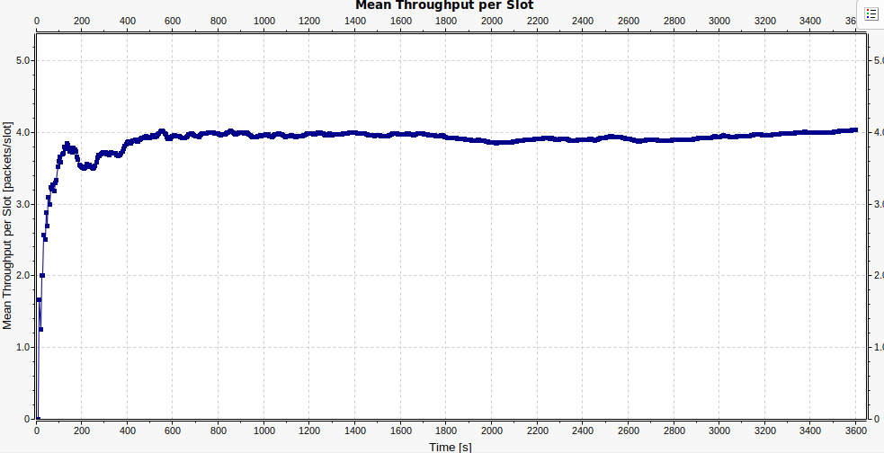
Verification (1)
Consistency Test
Continuity Test
N=1; C=500; p=1; 1/λ= 10s (deterministic);$T_{slot}$=5s
N=8; C=20; p=1; 1/λ= 10s (deterministic);$T_{slot}$=5s
N=2; C=500; p=1; 1/λ= 20s (deterministic);$T_{slot}$=5s
N=10; C=20; p=1; 1/λ= 10s (deterministic);$T_{slot}$=5s

Slide 13
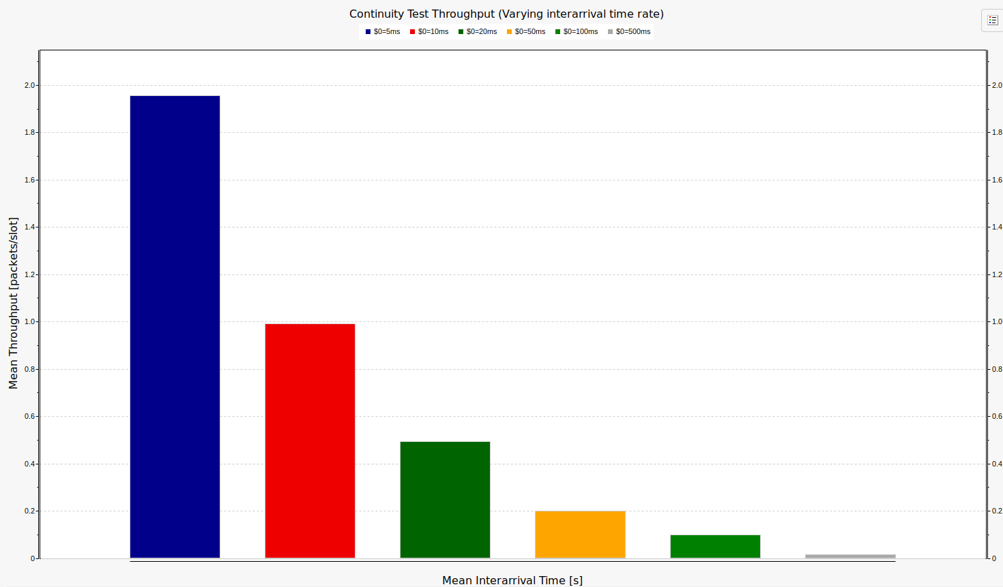
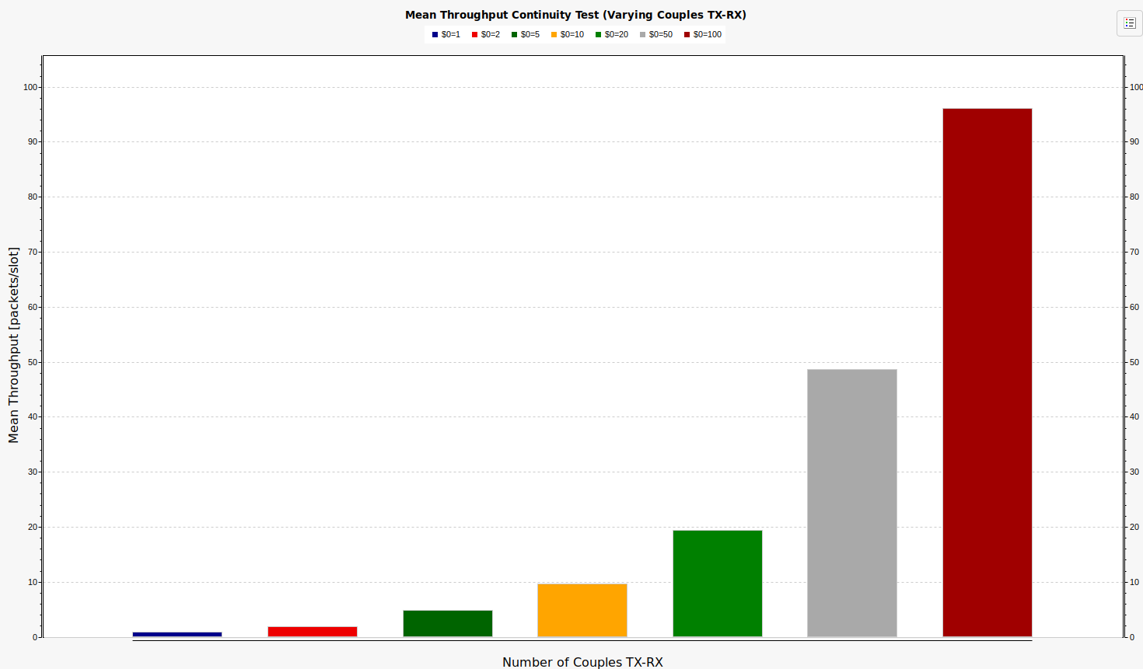
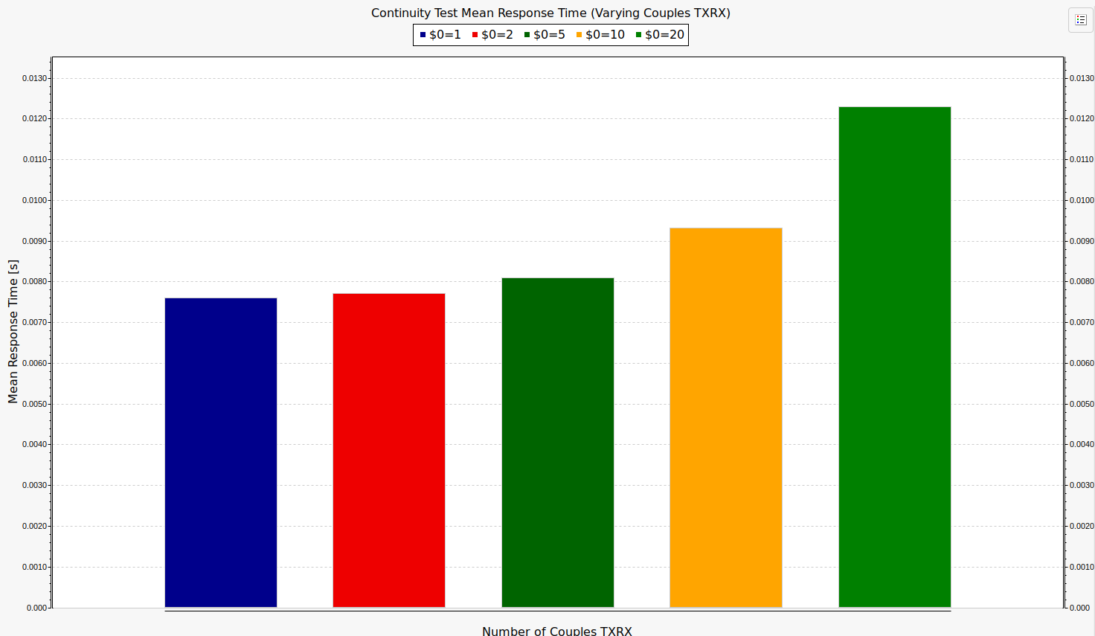
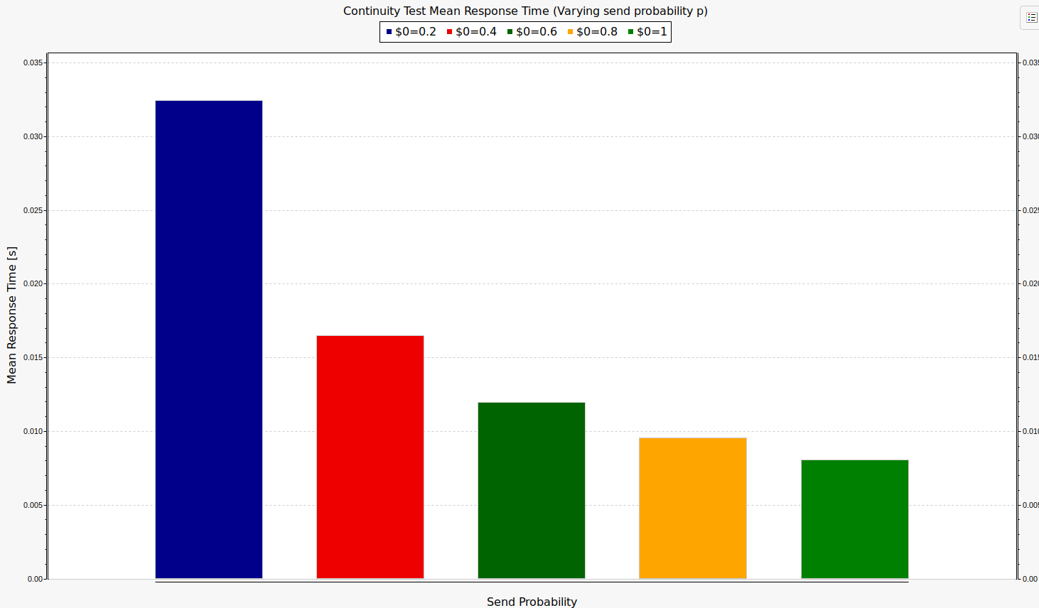
Verification (2)
KPI Monotonicity

Slide 14
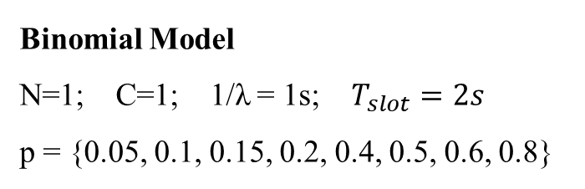
Verification (3)
Binomial Model
N=1; C=1; 1/λ = 1s; $T_{slot}=2s$
p = {0.05, 0.1, 0.15, 0.2, 0.4, 0.5, 0.6, 0.8}
Binomial Model And Collisions

Slide 15
Throughput Study
High Traffic Scenario
N = 30; C = 6; p = 0.1
Low Traffic Scenario
N = 5; C = 100; p=0.1

Slide 16
Response Time Study
High Traffic Scenario
N = 30; C = 6; 1/λ = 125ms
Low Traffic Scenario
N = 5; C = 100; 1/λ = 125ms

